Slide 1

PHYSICAL EDUCATION CENTER
Done by: Enas, Yaqeen

Slide 2
Whats this project about?
The Olympic Games provide a unique opportunity to study athletic performance, global competition, and social change over time. This project explores patterns within Olympic data to uncover factors that influence winning

Slide 3
Factors that influence winning a medal:
01
What factors are we exploring in this data?
02
Gender in the Olympics over time
• Does age, gender, weight, and height affect the likelihood of winning?
• Which countries win the most medals?
• How do medal count change across years for the top 5 countries?
• Which sports have the most medals, and for which countries?
• Count of male vs female athletes across decades.
• Identification of sports with the highest and lowest female participation across decades.
• Tracking women’s medal counts over time and comparing growth in participation vs success.

Slide 4
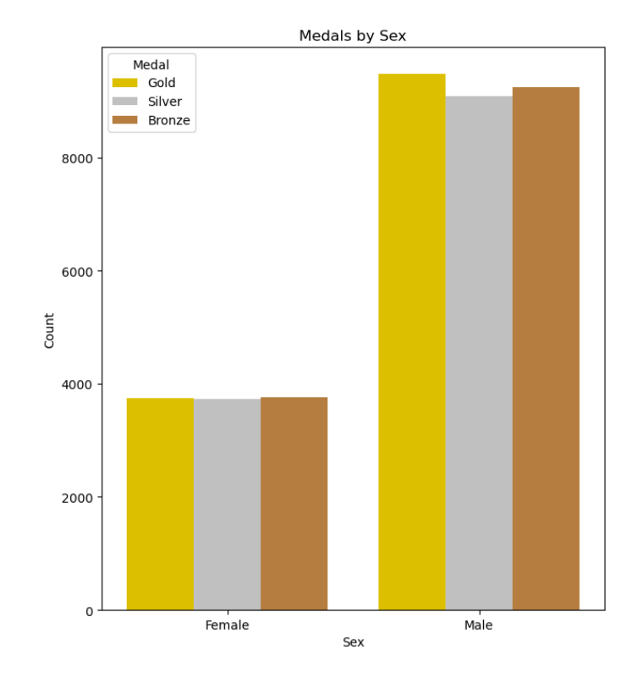
Males dominated the games across the decades, even though females numbers increased over time, but this is probably dues to the games having mostly only men for the first years

Slide 5
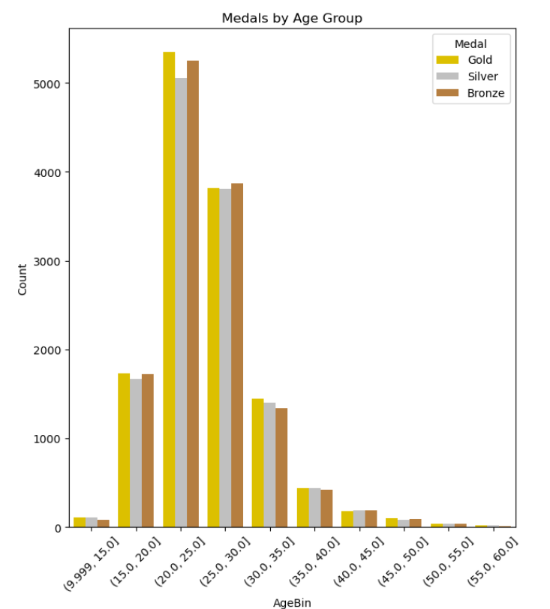
an obvious increase in winning for the age group between 20 and 25 then comes 25 to 30, where the person is in its youth, in the other hand a clear big decrease is in the smaller age group from 10 to 15 years and the larger age group between 55 and 60, this is probably because these age groups has less participants

Slide 6
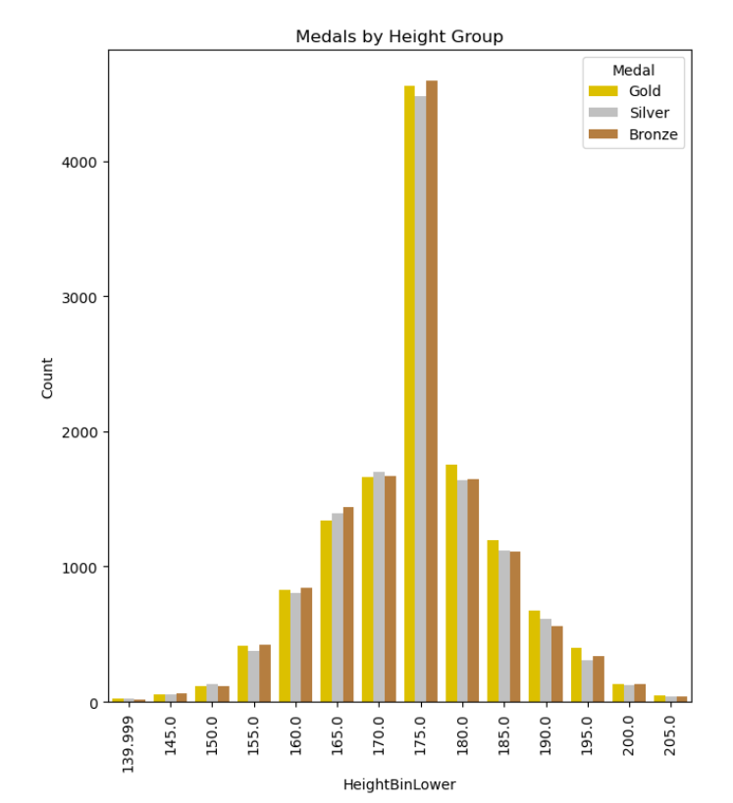
for the height, the 175 to 179 heights dominating the most with the rest height fallen between it.

Slide 7
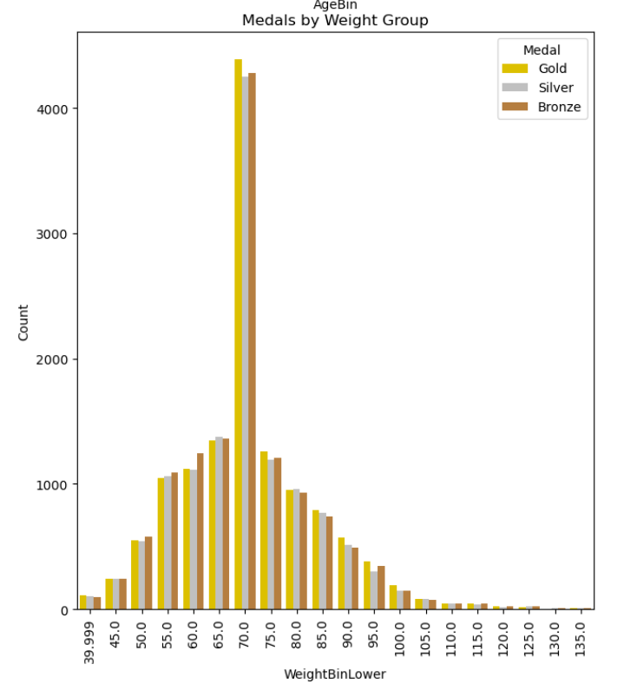
Finally, for the weight, similarly to the height we have a bin that s dominating which is the 70-74 weight bin, and the rest are falling between it at a much less winning count

Slide 8
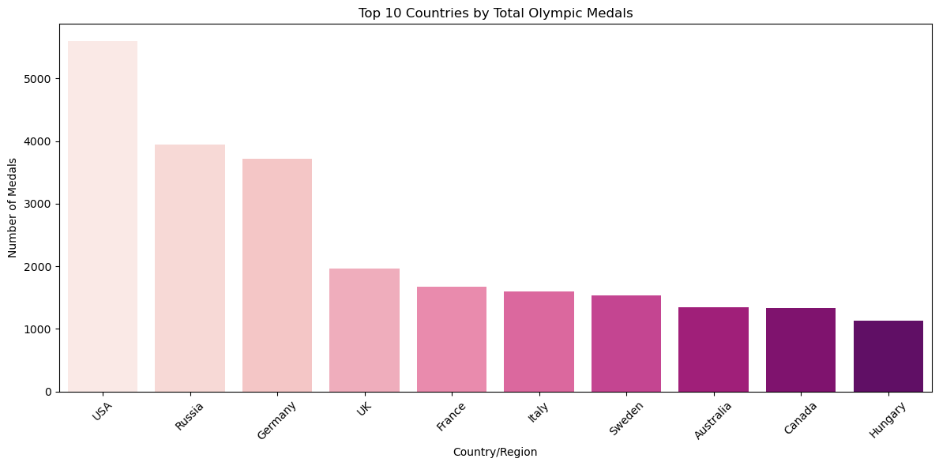
We can clearly see that the United States dominates with more than 5,000 medals. Russia and Germany follow, with close number of wins, while the remaining countries trail behind with gradually smaller but still significant totals.

Slide 9
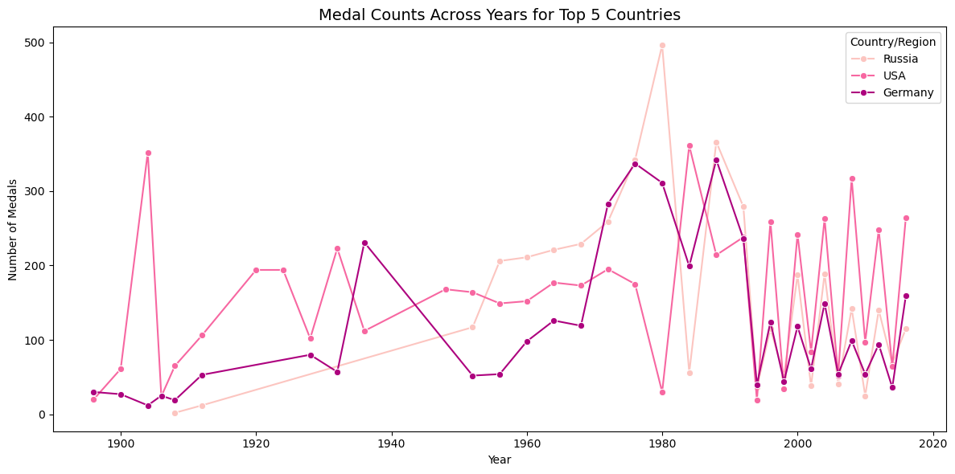
For the line plot, its showing the performance of the top 3 countries across the decades, The USA dominates medal counts over time, while Russia and Germany show strong but fluctuating performances shaped by historical events.

Slide 10
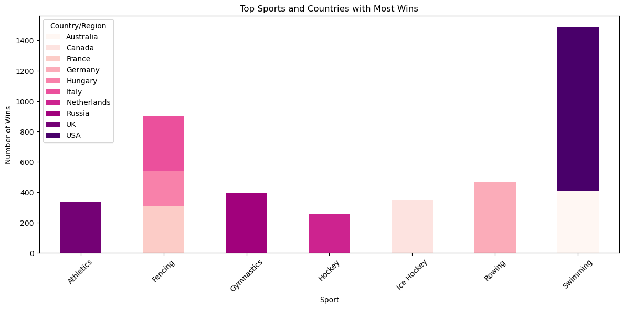
As for the stacked bar, it shows the top sports for the top winning countries. The USA leads in swimming, while fencing is shared across France, Italy, and Hungary, and Russia which shows strength in gymnastics.

Slide 11
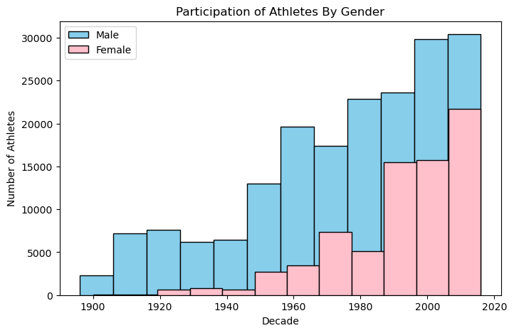
The diagrams illustrate that female participation in the Olympics has steadily increased since the early 1900s. A clear upward trend is visible from the mid-20th century onwards, showing that women have been consistently gaining a stronger presence in Olympic sports.

Slide 12
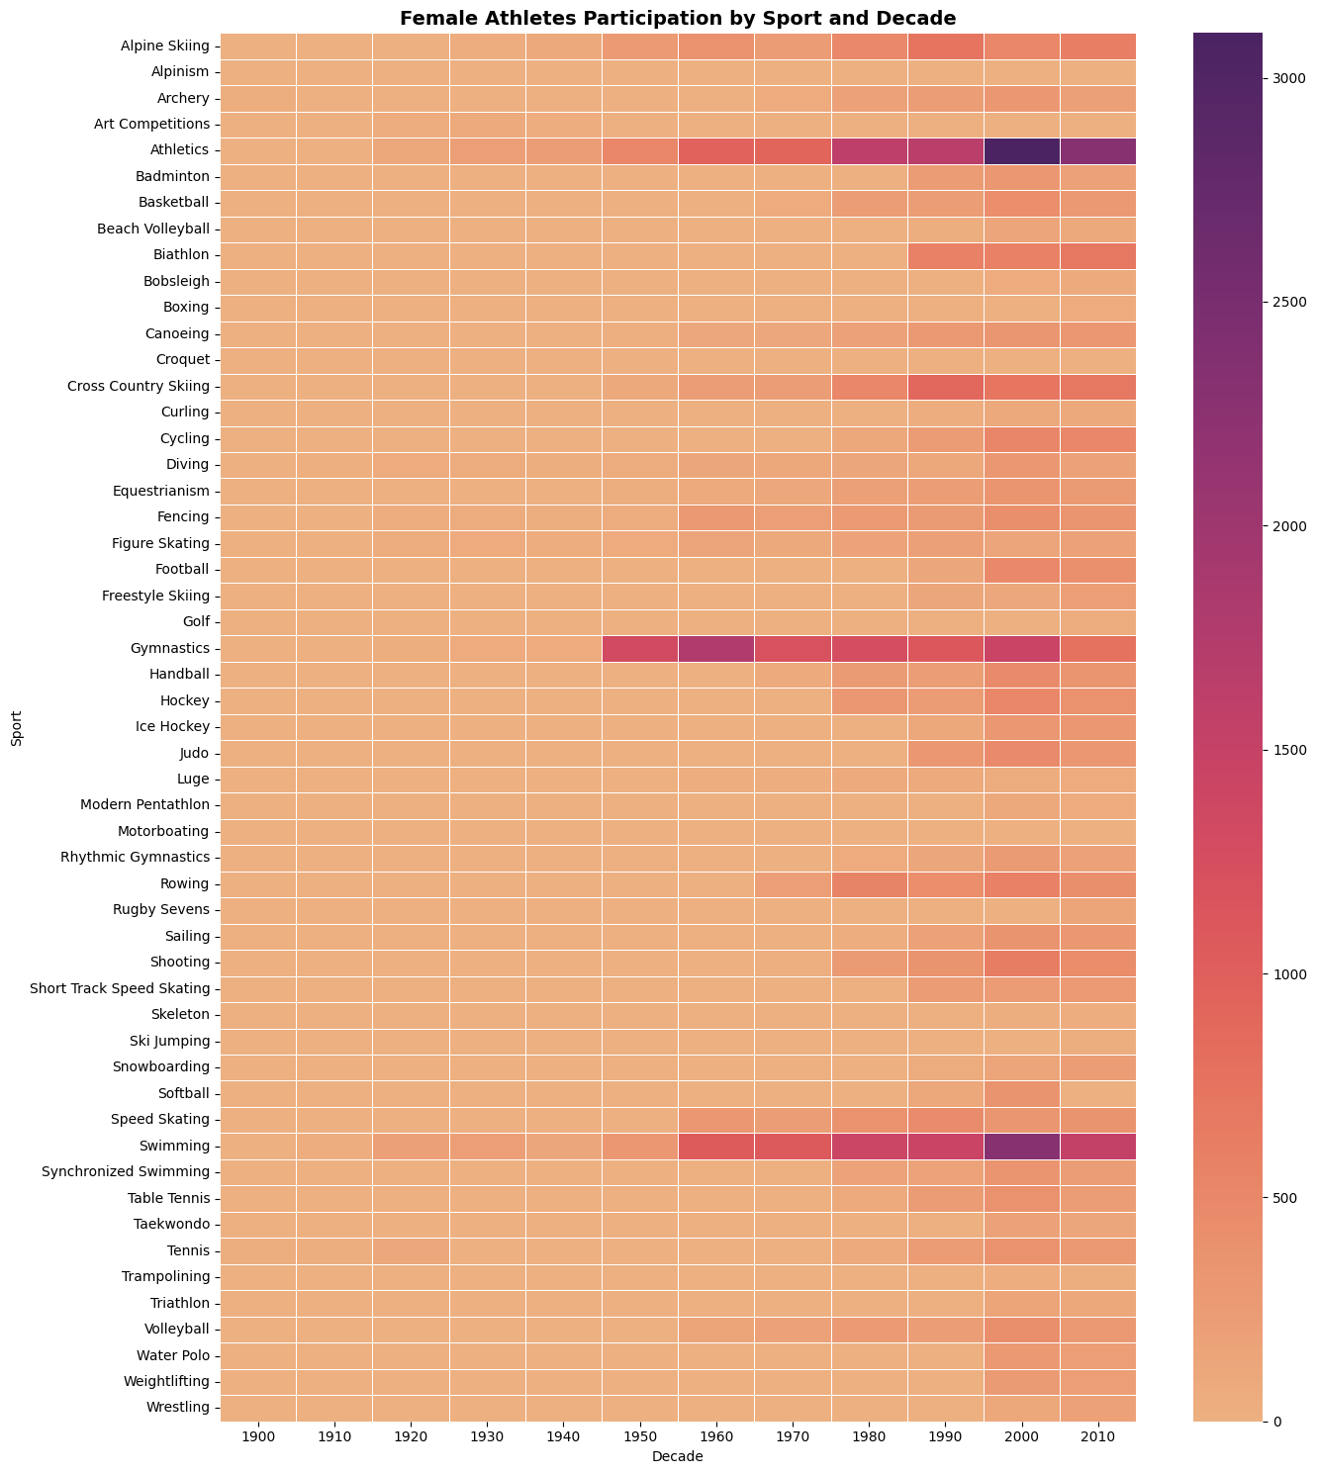
2010s. Sports such as Athletics, Golf, and Swimming demonstrated remarkable growth in female representation, reflecting greater opportunities and inclusivity during this period.

Slide 13
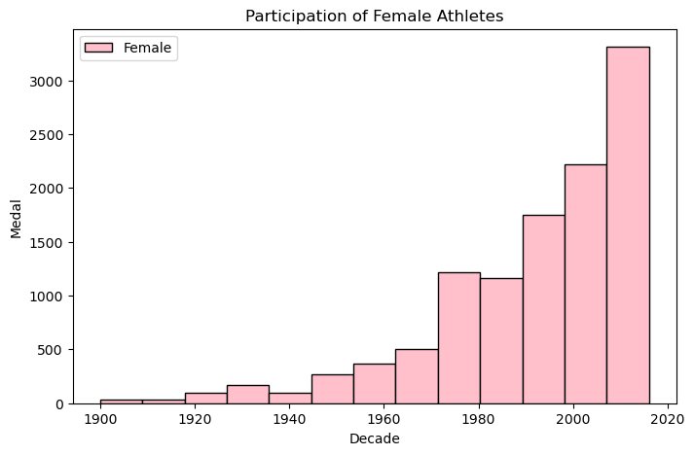
While the number of female athletes has grown rapidly—especially since 2010—the diagrams also show that male participation remains higher. On average, men still outnumber women by almost 50%, indicating progress but also highlighting ongoing gender disparities in sports participation.

Slide 14

Conclusion
The analysis shows that Olympic success is influenced by age, height, and weight, with athletes aged 20–30 and in specific height and weight ranges winning more medals. The USA dominates overall, followed by Russia and Germany, while certain countries specialize in sports like fencing or gymnastics. Female participation has steadily increased over time, though men still remain the majority.

Slide 15

Reccomendations
Future studies could use predictive models to forecast medal outcomes and include recent Olympic data for updated insights. Efforts should also focus on understanding barriers to women’s participation and promoting inclusivity across all sports

Slide 16

THANKS

